Slide 1
Topic: Measurement
EQ: How do I use formulas to calculate the volume of cylinders and solid sectors?

Slide 2
Learning Intentions
Students will be able to
- Calculate the volume of cylinders and solid sectors from a given diagram.
- Interpret a familiar worded question to draw a diagram, and calculate the volume of cylinders and solid sectors.

Slide 3

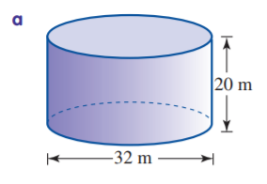
Starter – Daily 5
1.
For the data summarized above, the most likely type of distribution is:
A a negatively skewed distribution
B a positively skewed distribution
C skewed to the left
D a bimodal distribution
E a symmetric distribution.
2. Calculate the surface area of the cylinder

Slide 4
 | Goal-setting for Year 9 Measurement
Week/s | A | B | C | D
4 | Solves complex word problems involving surface area of cylinders and solid sectors, including inverse calculations. | Interprets a familiar worded question to draw a diagram, and calculate the surface area of cylinders and solid sectors. | Calculates the surface area of cylinders and solid sectors from a given diagram. | Incorrectly uses formula to perform calculation of surface area of cylinders and solid sectors.
5 | Solves complex word problems involving volume of cylinders and solid sectors, including inverse calculations. | Interprets a familiar worded question to draw a diagram, and calculate the volume of cylinders and solid sectors. | Calculates the volume of cylinders and solid sectors from a given diagram. | Incorrectly uses formula to perform calculation of volume of cylinders and solid sectors.

Slide 5
24
7
30
Topic: Measurement
Date:
EQ: How do I use formulas to calculate the volume of cylinders and solid sectors?
RECALL: What is the general rule for the volume of a solid shape?
Volume= Area of base x Height
Discussion and clarification about “base “of right prisms and cylinders
Discussion and formation of the following volume formulas:
Volume formula of a cylinder | Volume formula of a solid sector

Slide 6
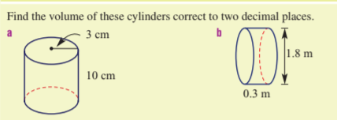
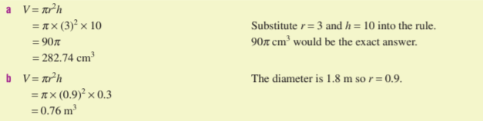
24
7
30
Topic: Measurement
Date:
EQ: How do I use formulas to calculate the volume of cylinders and solid sectors?
We do:

Slide 7
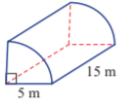
24
7
30
Topic: Measurement
Date:
EQ: How do I use formulas to calculate the volume of cylinders and solid sectors?
We do: Find the volume of this cylindrical portion
294.52 m3

Slide 8
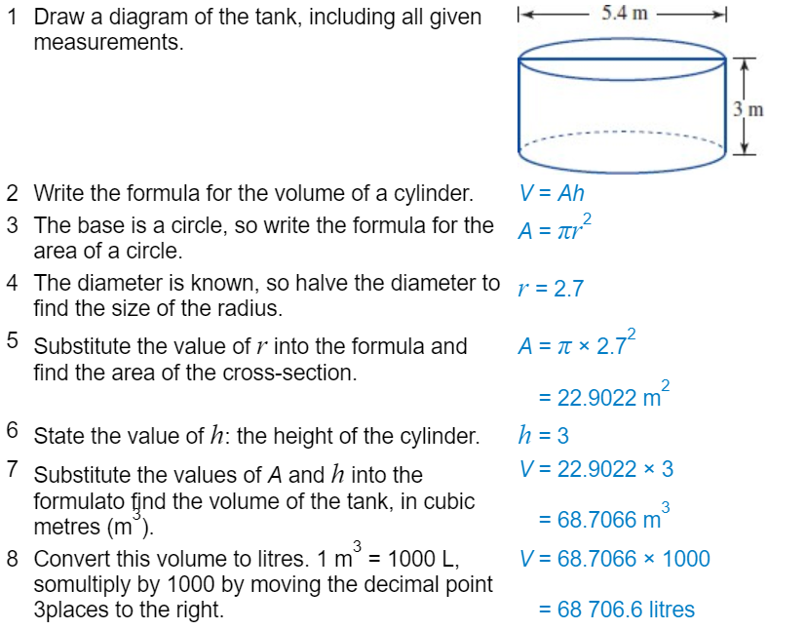
24
7
30
Topic: Measurement
Date:
EQ: How do I use formulas to calculate the volume of cylinders and solid sectors?
We do:
Key tip is to draw a diagram first

Slide 9
24
7
30
Topic: Measurement
Date:
EQ: How do I use formulas to calculate the volume of cylinders and solid sectors?
Complete Lesson 3_Volume of cylinders and solid sectors worksheet

